Slide 1




Data Communication Concepts
Static and Dynamic IP Addressing

Slide 2
Outline
Outline
Overview
Static IP Address Assignment
Dynamic (Automatic) IP Address Assignment
Static (Manual) versus Dynamic (Automatic) IP Configuration
DHCP (Dynamic Host Configuration Protocol) Service
Simulation in Packet tracer

Slide 3
Overview
Outline
In this lab, we will learn about static and dynamic IP addressing.

Slide 4
Static IP Address Assignment
Outline
By default, client computers obtain TCP/IP configuration information automatically from the Dynamic Host Configuration Protocol (DHCP) Service. However, even in a DHCP-enabled environment, you should assign a static IP address to selected network computers.
For example, a computer running the DHCP service cannot be a DHCP client, so it must have a static IP address.
If the DHCP Service is not available, you must also configure the computer to use a static IP address. For each network adapter card that uses TCP/IP in a computer, you can configure an IP address, subnet mask, and default gateway.

Slide 5
Outline
Dynamic (Automatic) IP Address Assignment
If a server running the DHCP Service is available on the network, it can automatically assign the configuration information to the DHCP client.
Using DHCP to configure TCP/IP automatically on client computers can simplify administration and ensure correct configuration information.
To use the DHCP service to provide clients with the configuration information automatically, however, you must first configure a computer as a DHCP client.
To configure a DHCP client, open the TCP/IP properties dialog box and click obtain an IP address automatically (by DHCP).

Slide 6
Outline
Dynamic (Automatic) IP Address Assignment (Continue…)
NOTE: In a small private network where a DHCP server is not available, you can use the Windows 2000 Server feature called Automatic Private IP Addressing (APIPA) to automatically assign IP addresses for you.
The Internet Assigned Numbers Authority (IANA) has reserved 169.254.0.0 through 169.254.255.255 for Automatic Private IP Addressing.

Slide 7
Outline
Static (Manual) versus Dynamic (Automatic) IP Configuration
Configuring TCP/IP manually | Configuring TCP/IP using DHCP
Users can pick an IP address at random rather than obtaining a valid IP address from the network administrator. | Users no longer need to acquire IP addressing information from an administrator to configure TCP/IP.
Typing in the IP address, subnet mask, or default gateway can lead to problems ranging from difficulty communicating, if the default gateway or subnet mask is incorrect, to problems associated with a duplicate IP address. | Valid IP addressing information ensures correct configuration, which eliminates most difficult-to-trace network problems.
There is administrative overhead for networks if you frequently move computers from one subnet to another. | Having servers running the DHCP Service on each subnet eliminates the overhead associated with having to manually reconfigure IP addresses, subnet masks, and default gateways when you move computers from one subnet to another.

Slide 8
Outline
DHCP (Dynamic Host Configuration Protocol) Service
DHCP is a TCP/IP standard for simplifying the management of IP configuration.
Each time a DHCP client starts, it requests IP addressing information from a DHCP server. This addressing information includes the following:
An IP address
A subnet mask
Optional values, such as a default gateway address and a DNS server address.

Slide 9
Outline
DHCP (Dynamic Host Configuration Protocol) Service
When a DHCP server receives a request for an IP address, it selects IP addressing information from a pool of addresses defined in its database and offers the IP addressing information to the DHCP client.
If the client accepts the offer, the DHCP server leases the IP addressing information to the client for a specified period.

Slide 10
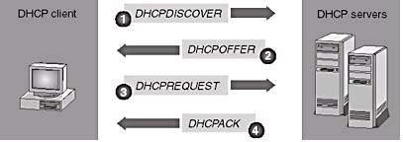
Outline
DHCP (Dynamic Host Configuration Protocol) Service
The DHCP Lease Process
DHCP uses a four-phase process to lease IP addressing information to a DHCP client for a specific period: DHCPDISCOVER, DHCPOFFER, DHCPREQUEST, and DHCPACK.

Slide 11
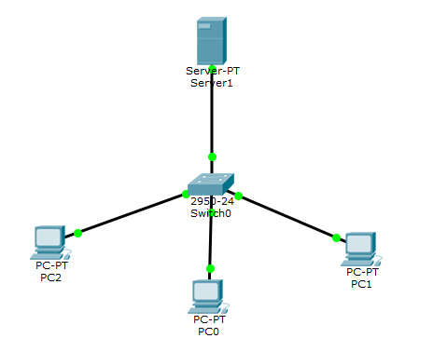
Outline
Simulation of DHCP in Packet Tracer
for the following network assign a TCP/IP configuration information for each needed device in packet tracer;
1. Using static IP addressing assignment
2. Using dynamic IP assignment, DHCP server is not available.
3. Using dynamic IP assignment with existence of DHCP server.

Slide 12


THANK YOU

